Slide 1

COVID-19 case analysis
Team members:
Grecia Villarreal
Abelardo Villalobos
Edwin Rosales
Daniel Orta
Team members:
Grecia Villarreal
Abelardo Villalobos
Edwin Rosales
Daniel Orta

Slide 2
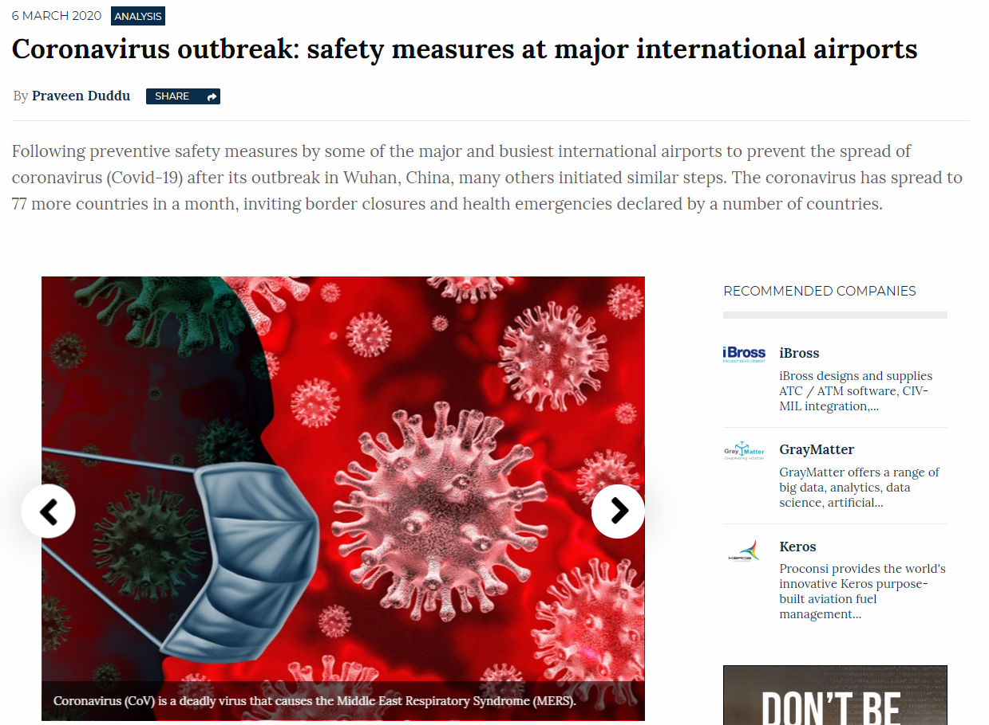
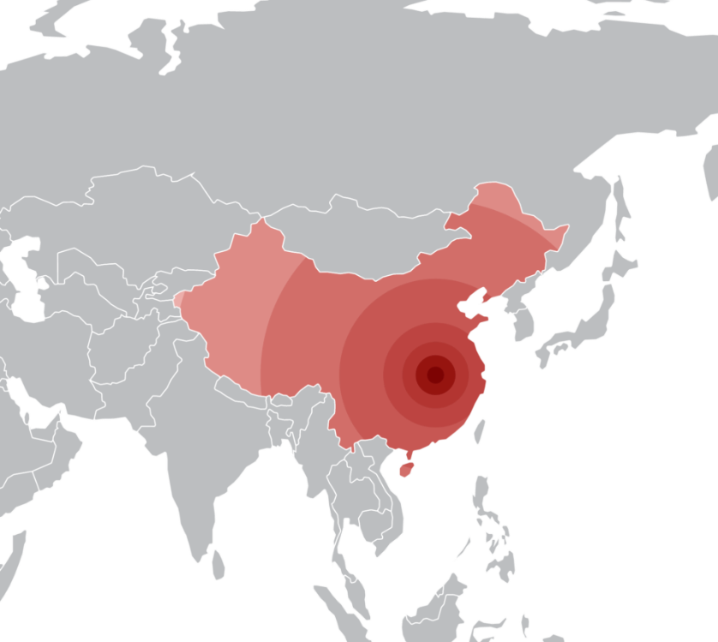
Motivation & Summary
COVID-19 is being the headline in the entire world for the last 3 months, it affects not just Health Sector, but some other like Economy, Finances, Tourism, among others.
The scope of our project is to analyze the evolution of the virus in humans: confirmed cases, deaths and recoveries.
We are seeking validation of the effectiveness of public policy adopted by China (Dictatorial Regime-One Party) versus the Rest of the World, regarding the specific case of COVID-19 spread.

Slide 3
Questions we want to answer:
What is the percentage of recovered, death and active cases worldwide? This will help us understand the overview of the current status of the virus.
How many confirmed, death and recovered cases there are per day across the world? This will help us understand how have the cases increased worldwide in a daily basis and the cumulative comparison of the different status of the disease.
What is the concentrations of cases by region? To visually represent the spread of COVID-19 cases globally.
What is the rate of increase in confirmed cases in China compared to the rest of the world? This will help us identify if measures haven been taken in these two regions and identify their effectiveness in general.

Slide 4
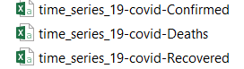
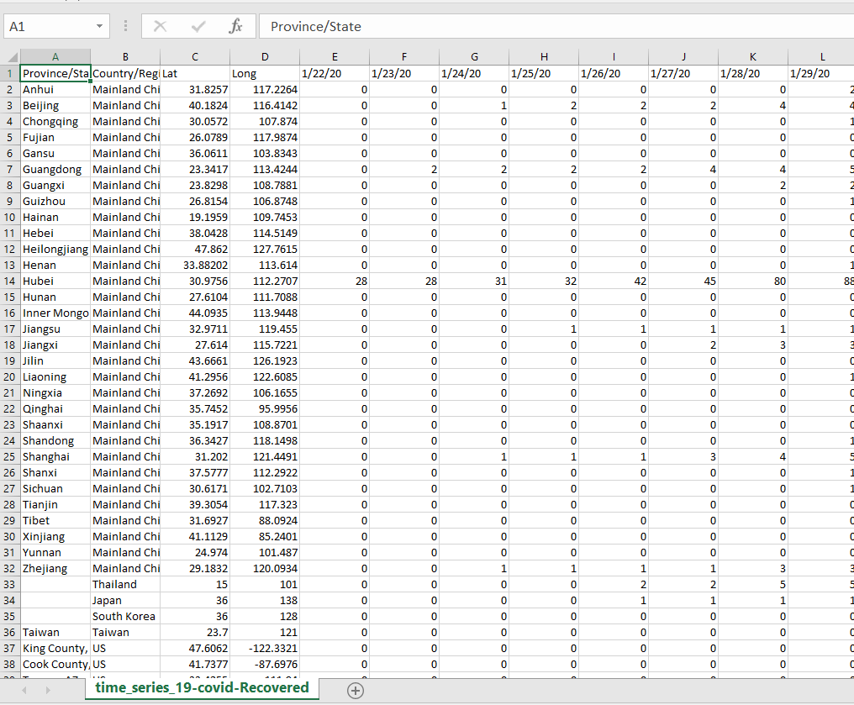
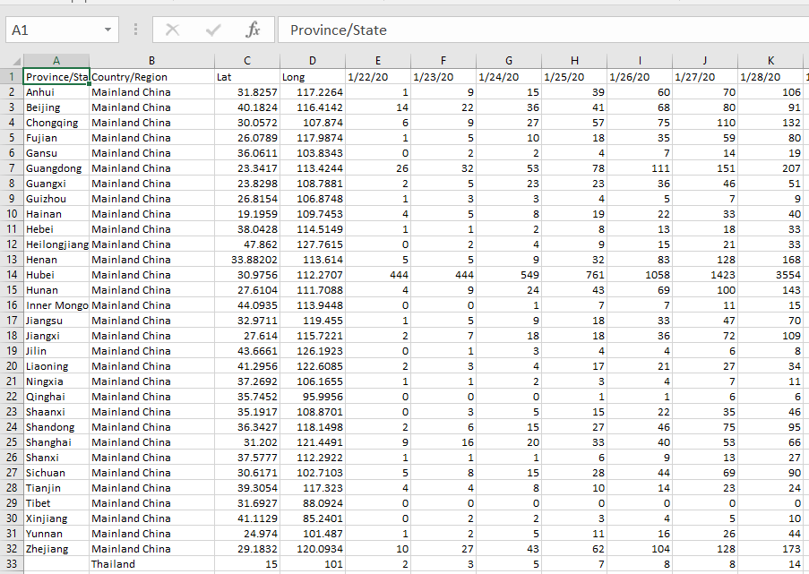
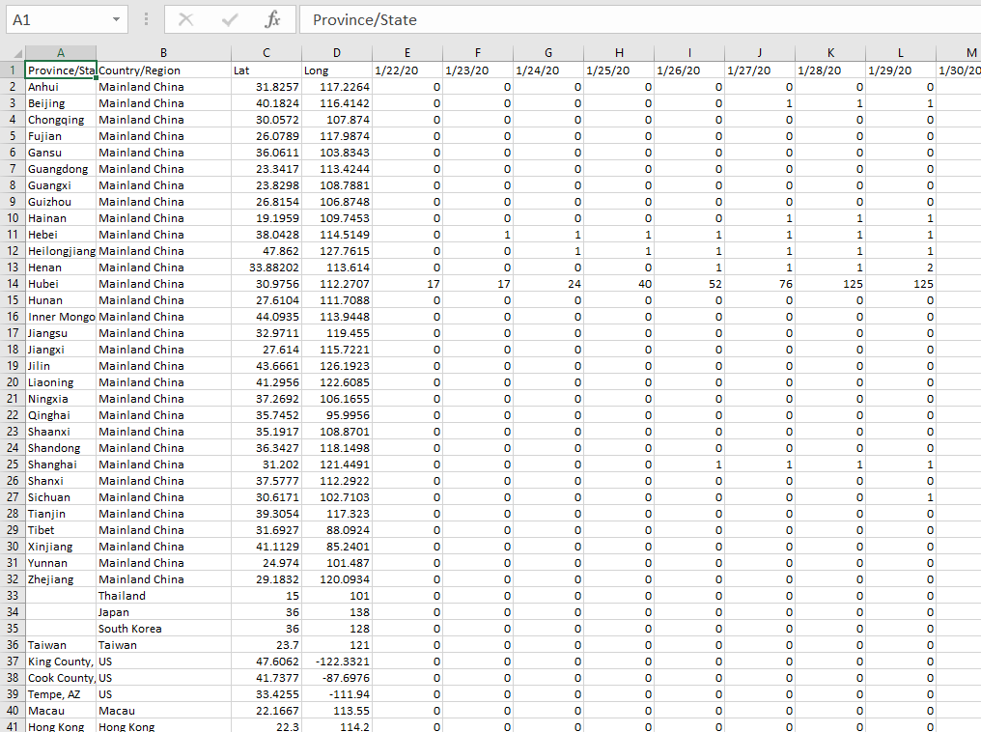
Data Cleanup & Exploration
We found three public csv´s of data updated daily, that we consolidated, transposed and aggregated to get the data in the format we needed it to create our visualizations and answer our questions.

Slide 5
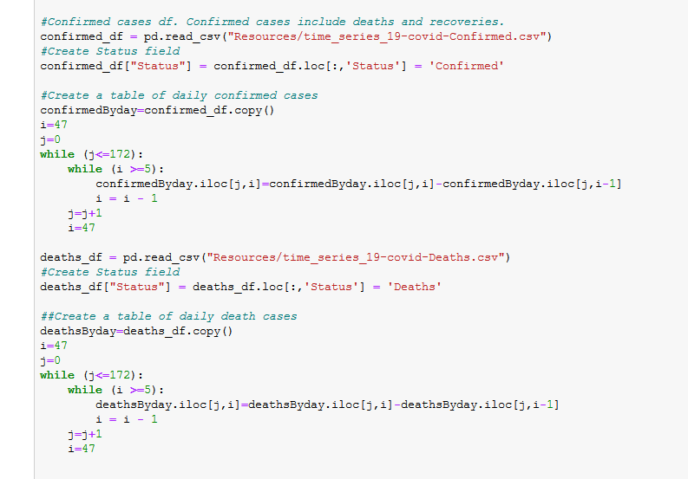
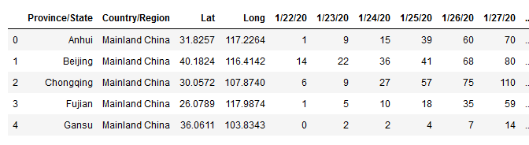
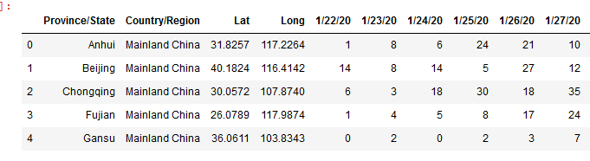
Data Cleanup & Exploration
We had cumulative numbers, while for some analysis we needed the daily cases. We applied a loop calculation to have both options as separated data frames.
Before
After

Slide 6
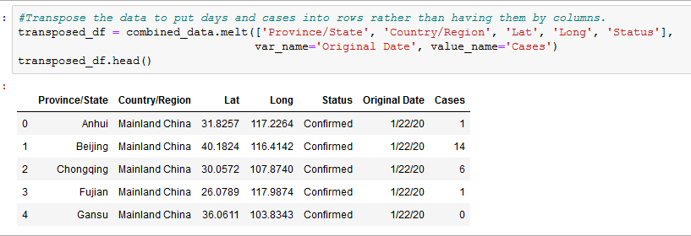
Data Cleanup & Exploration
The days in our data source were added in columns, but we needed a different structure to be able to analyze it easily. We transposed the data to have days and cases into rows.

Slide 7
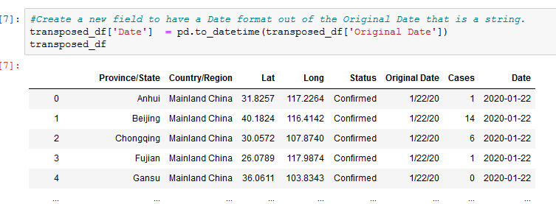
Data Cleanup & Exploration
The day format was improtant for the charts to show the information chronologically. We applied a timeseries function to create a new date field with correct date format.

Slide 8
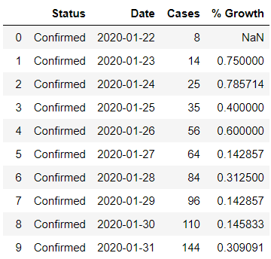
Data Cleanup & Exploration
Also, the calculation and addition of new fields was necessary to create some of the charts:

Slide 9
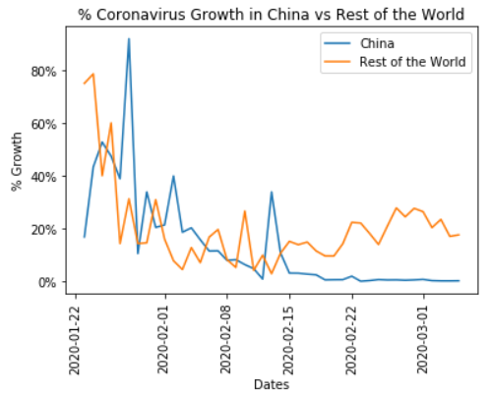
Visualization

Slide 10
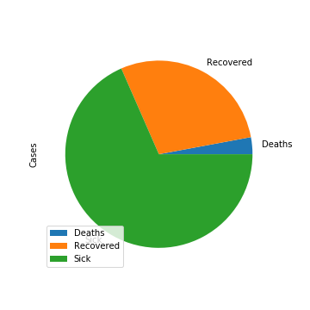
Visualization

Slide 11
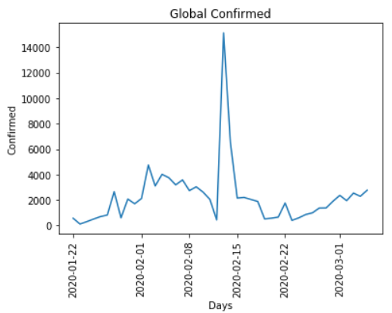
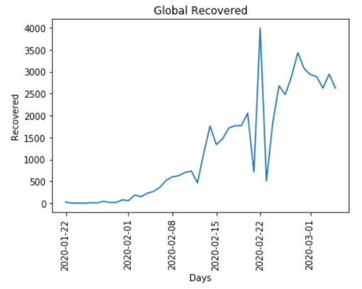
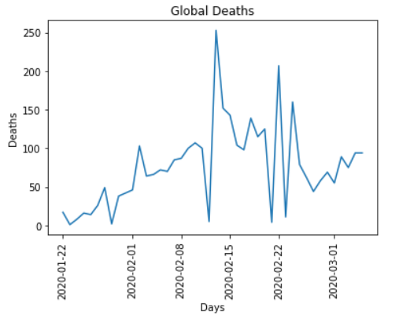
Visualization

Slide 12
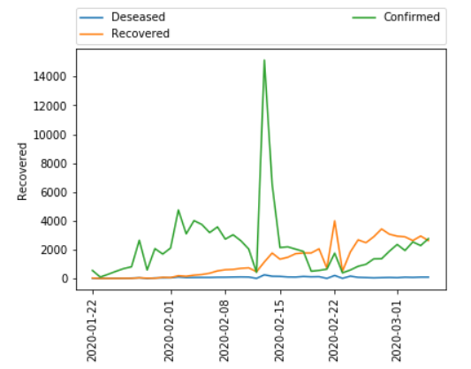
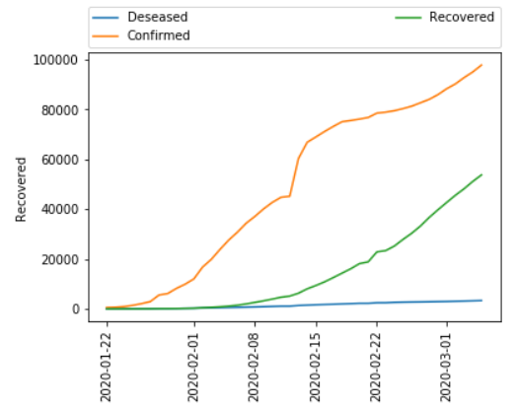
Visualization
Global Day by Day
Global Cumulative

Slide 13
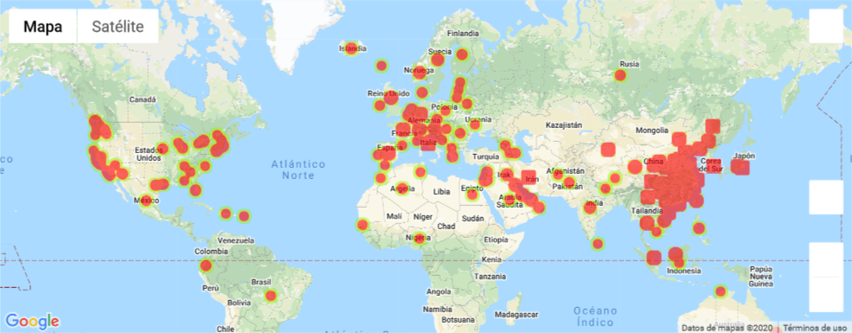
Visualization

Slide 14
Questions & Data
We were able to successfully answer the questions posed in our scope.
From our results, we conclude that COVID-19 death rate represent on average 3.5% of the total confirmed cases worldwide. Additionally we found that, even though the confirmed cases have steadily increased around the world, the increase in deaths remain relatively stable.
The number of confirmed cases in China remains predominant compared to the cases reported in the rest of the world.

Slide 15
Data Analysis
We downloaded the data from the reports’ GitHub page, processed it, removed data that we did not need, transformed the tables to the convenience of each chart, we also added the fields and variables needed for analysis, investigated libraries, and used this information to plot. Once we had the charts, we were able to answer our questions.

Slide 16
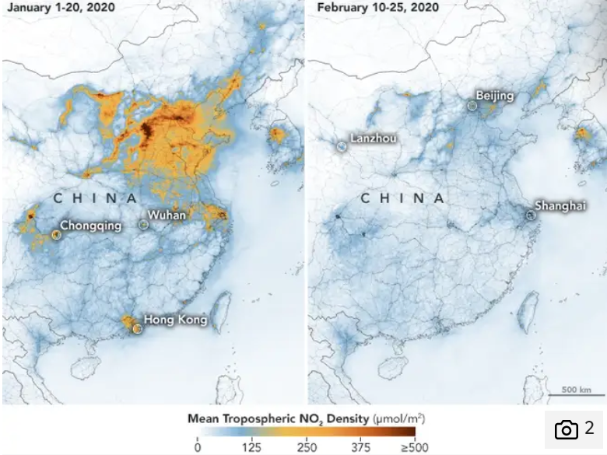
Discussion
As per the data shown in plot "% Coronavirus growth vs the rest of the world", the trend of cases in China shows a clear decreasing tendency that starts in mid February and continues until march, while the cases confirmed in rest of the world, show an increase of approximately 25% in the same time frame (2 weeks).

Slide 17
POSTMORTEM
The data updates everyday.
ApiKey for GoogleMaps Api.
Join the notebooks into one functional Notebook.
Cross-regional datain order to analyze the spreading of the virus in small environments.

Slide 18
Q&A

Slide 19
Thank you!

